Slide 1
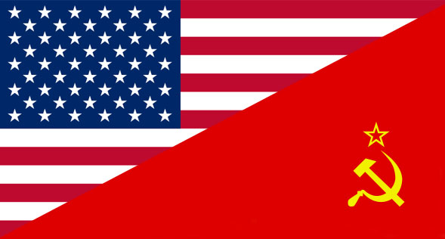
The Cold War (1947-1991)

Slide 2
The Cold War (1947-1991)
The end of the Alliance
USA, Britain and USSR defeated the Axis
However, their alliance started to crumble shortly, even before defeating Hitler, differences between them showed up
By 1947, the Cold War had started

Slide 3
The Cold War (1947-1991)
Cold War (1947-1991)
Long period of rivalry between USA and USSR and their allies
Several wars, but no direct confrontation between both superpowers

Slide 4
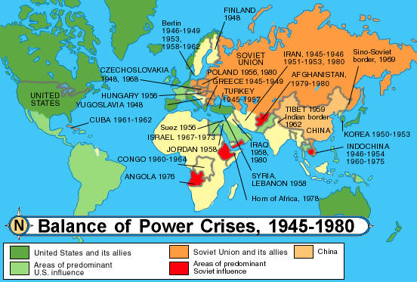
The Cold War (1947-1991)

Slide 5
The Cold War (1947-1991)
The Cold war was fought in different fronts
Political → Democracy/Soviet dictatorship (although Franco was supported by the USA)
Economic → Capitalism/Centralized Soviet economy
Propaganda → Two ways of life

Slide 6
The Cold War (1947-1991)
The Cold war ended with the collapse of the USSR
Inefficient economic system
Lack of freedoms

Slide 7
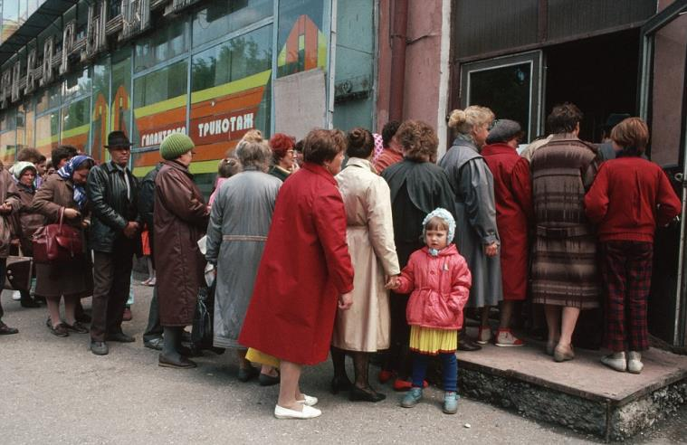
The Cold War (1947-1991)

Slide 8
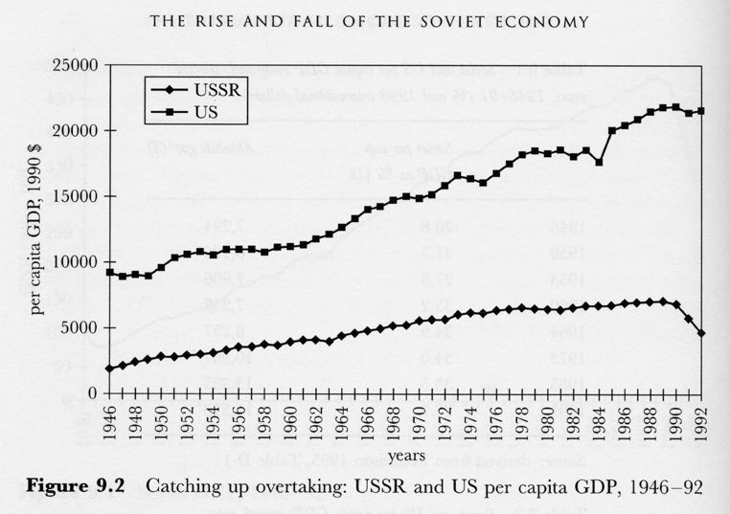
The Cold War (1947-1991)

Slide 9
The Cold War (1947-1991)
The world divided into two blocks 1945-1955
Stalin imposed Communism in Central Europe (1945-1948)
Soviet Germany, Poland, Hungary, Romania, Bulgaria
Yugoslavia and Albania
Churchill’s «Iron Curtain»

Slide 10
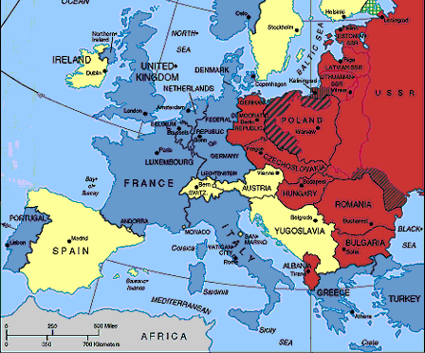
The Cold War (1947-1991)

Slide 11
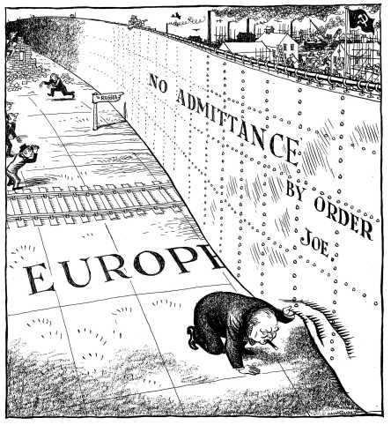
The Cold War (1947-1991)

Slide 12
The Cold War (1947-1991)
The world divided into two blocks 1945-1955
American reaction:
«Containment policy» proclaimed by Truman in 1947 (Truman Doctrine)
«Marshall Plan» 1947

Slide 13
The Cold War (1947-1991)
The world divided into two blocks 1945-1955
«Containment policy» proclaimed by Truman in 1947 (Truman Doctrine)
Britain gave up helping Greece
US took over → Any other communist aggresion will be contained by the US

Slide 14
The Cold War (1947-1991)
The world divided into two blocks 1945-1955
«Marshall Plan» 1947
Economic aid to Europe
Less poverty, less attraction on Communism
Recover European economy

Slide 15
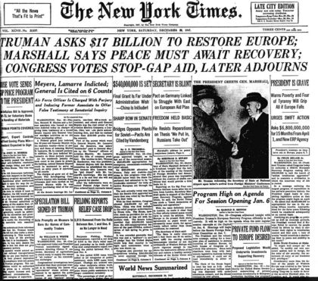
The Cold War (1947-1991)

Slide 16
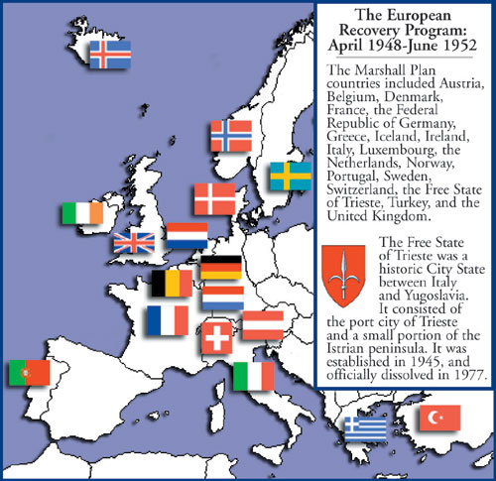
The Cold War (1947-1991)
Spain was excluded
because of Franco’s
Dictatorship

Slide 17
The Cold War (1947-1991)
The world divided into two blocks 1945-1955
Germany and Berlin: four occupation zones (UK, US, Fr. & USSR)
Cold war caused the division of Germany and Berlin
FRG (Western Germany) DRG (Eastern Germany)
Western Berlin isolated within DRG

Slide 18
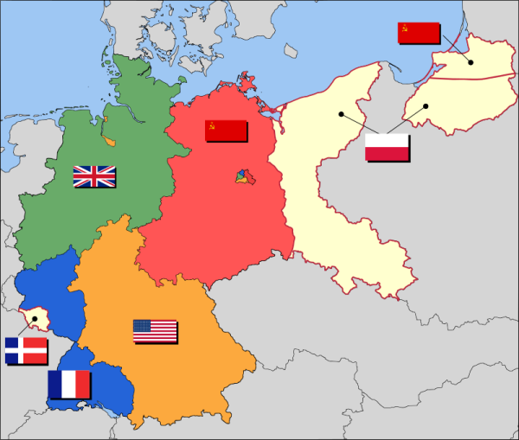
The Cold War (1947-1991)

Slide 19
The Cold War (1947-1991)
The victory of the Chinese communist revolution
Increasing anxiety in the West
Mao Zedong – October 1949
The world’s most populous country joined the communist bloc

Slide 20
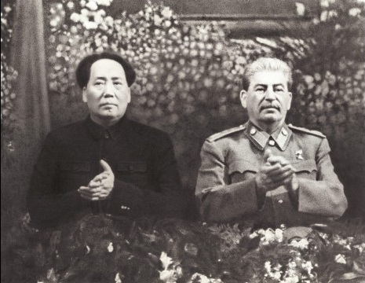
The Cold War (1947-1991)

Slide 21
The Cold War (1947-1991)
The Soviet Union carried out its first atomic bomb test
August 1949, a few months earlier than the victory of the Chinese communists

Slide 22
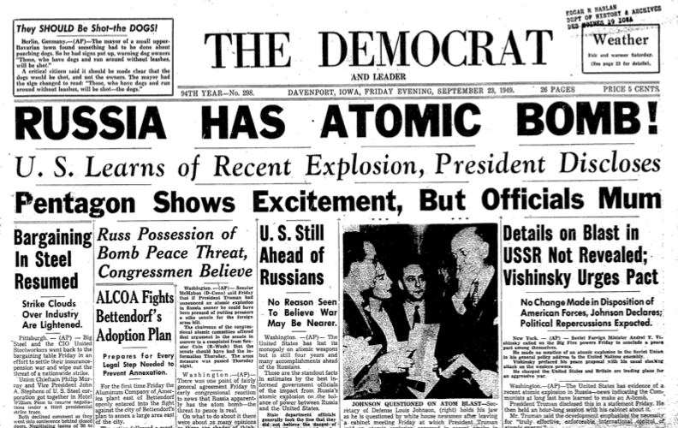
The Cold War (1947-1991)

Slide 23
The Cold War (1947-1991)
The Bipolar World (1949-1955)
The world got divided into to blocs led by the USA and the USSR
Military alliances were established all over the world

Slide 24
The Cold War (1947-1991)
The Bipolar World (1949-1955)
1949 →NATO: North Atlantic Treaty Organisation (Millitary alliance of the USA and its allies). Spain could not join until 1982
European Economic Community, 1957 (Now European Union)

Slide 25
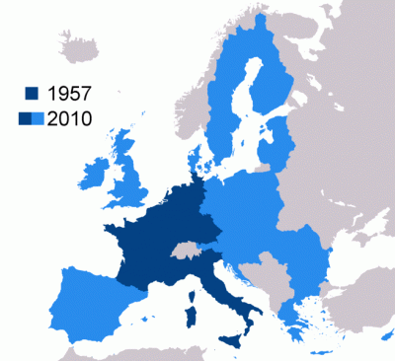
The Cold War (1947-1991)

Slide 26
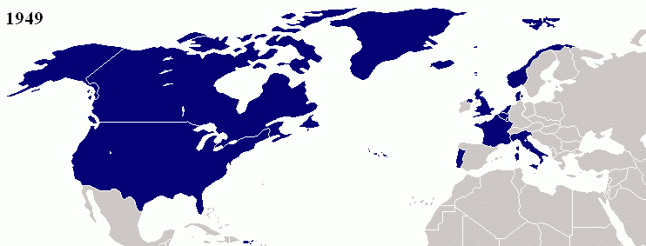
The Cold War (1947-1991)

Slide 27
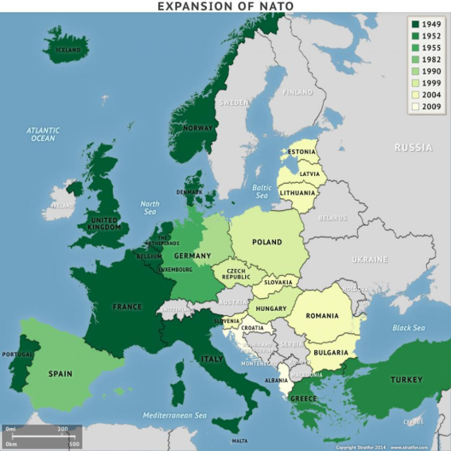
The Cold War (1947-1991)

Slide 28
The Cold War (1947-1991)
The Bipolar World (1949-1955)
1955 → Warsaw Pact (Millitary alliance of the USSR and its allies in Central and Eastern Europe)
Yugoslavia, although a communist country, did not join the alliance
1949 → China and the USSR signed different agreements

Slide 29
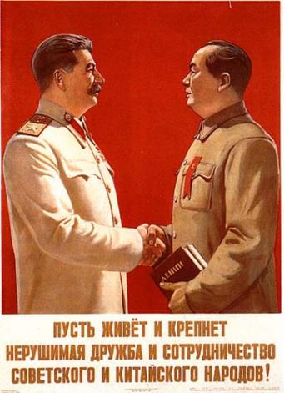
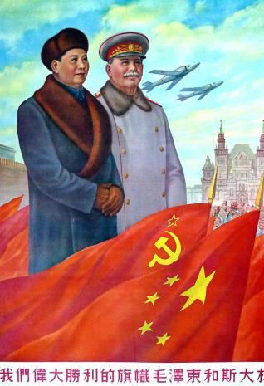
The Cold War (1947-1991)

Slide 30
The Cold War (1947-1991)

Slide 31
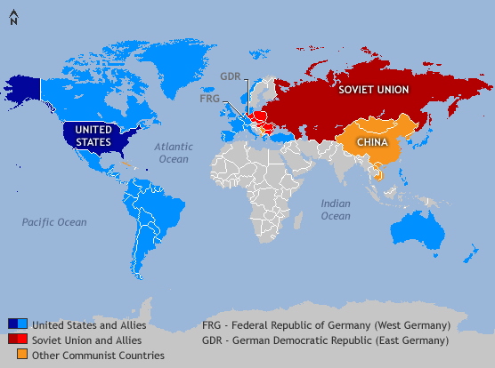
The Cold War (1947-1991)

Slide 32
The Cold War (1947-1991)
Peaceful Coexistence (1955-1962)
New atmosphere → the «thaw»
However, there were serious international crisis
1953 → Stalin died and was substituted by Khruschev
Khruschev talked about «peaceful coexistence»

Slide 33
The Cold War (1947-1991)
Peaceful Coexistence (1955-1962)
Why the «thaw»?
Balance of terror → Mutually assured destruction (both superpowers had accumulated a great number of atomic weapons)
Nobody could win a nuclear war

Slide 34
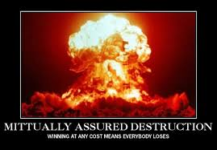
The Cold War (1947-1991)

Slide 35
The Cold War (1947-1991)
The construction of the Berlin Wall (1961)
Division of Germany
1951-1958: More than 2 million left GDR (Communist Germany), lots of them through Berlin
1961: Berlin was erected
West Berlin got completely isolated
Symbol of the Cold War

Slide 36
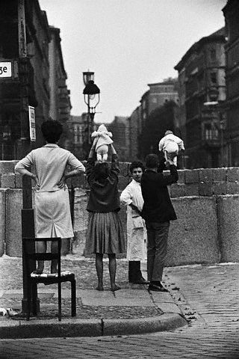
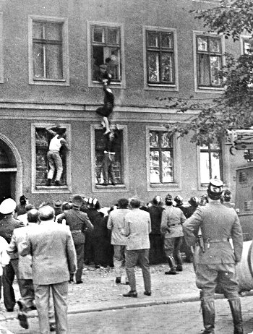
The Cold War (1947-1991)

Slide 37
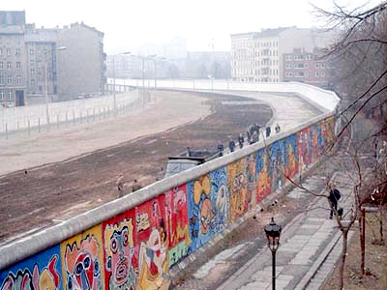
The Cold War (1947-1991)

Slide 38
The Cold War (1947-1991)
Cuban Missile Crisis (1962)
1959, Castro’s revolution
Pigs’ Bay– Playa Girón, 1961: Failed attempt of invading Cuba
Castro asked the URSS to deploy nucelar missiles in the island
1963, US spy planes discovered them

Slide 39
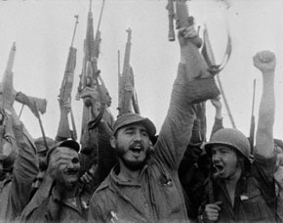
The Cold War (1947-1991)
Pigs’ Bay– Playa Girón, 1961
Failed attempt of invading Cuba

Slide 40
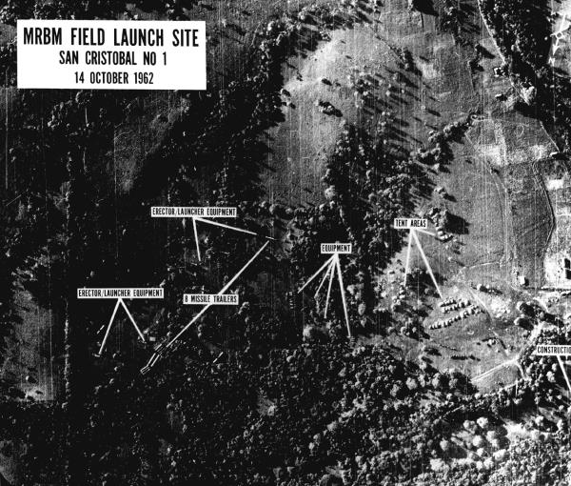
The Cold War (1947-1991)

Slide 41
The Cold War (1947-1991)
Cuban Missile Crisis (1962)
Kennedy’s reaction: blockade of the island
US proclaimed that its navy will prevent any Soviet ship from getting to Cuba
The moment the world was closest to a nuclear war
Finally, the Soviets withdraw the missiles from Cuba and the USA from Turkey

Slide 42
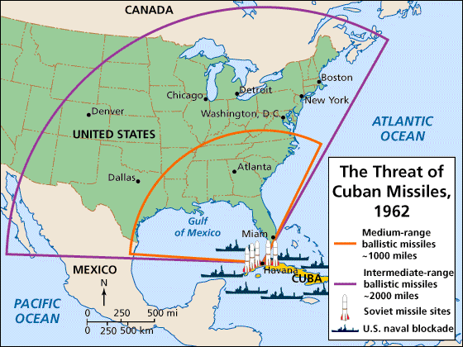
The Cold War (1947-1991)

Slide 43
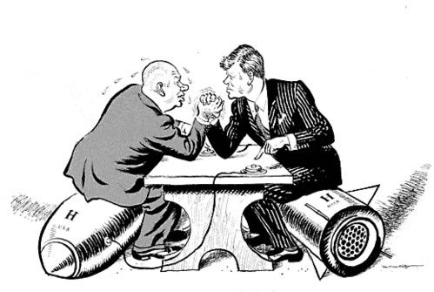
The Cold War (1947-1991)

Slide 44
The Cold War (1947-1991)
The end of the Sino-Soviet Alliance, 1962
Both communist powers broke relations
A long enemity started
Great news for the US and the western bloc
Ideological and strategic differences

Slide 45
The Cold War (1947-1991)
The Détente, 1962-1975
After being on the brink of starting a war in Cuba, both superpowers looked for a détente
Nuclear Non Proliferation Treaty, 1968
SALT I (Strategic Arms Limitation Agreement), 1972

Slide 46
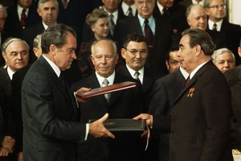
The Cold War (1947-1991)
Nixon and Brezhnev after singing SALT I

Slide 47
The Cold War (1947-1991)
The Détente, 1962-1975
However, local wars continued in which the USA and the USSR intervened
Middle East conflict (Israel with USA support, Arab countries with USSR’s)
Vietnam war (Military intervention of the USA)

Slide 48
The Cold War (1947-1991)
Vietnam war (1959-1975)
Vietnam got divided after WWII
Conflicts grew and the USA half million soldiers to fight N. Vietnam and the communist guerrilla («Vietcong»)
USA humiliated
North communist, South pro-western dictatorship
1975, Vietnam got reunified under a communist goviernment

Slide 49
The Cold War (1947-1991)
The new Cold War (1975-1985)
The West weakened by 1973 economic crisis (“oil crisis”)
Ronald Reagan (1980s) → policy of confrontation
More military expenses + feeble economy → collapse of the Soviet bloc
The USSR increased its interventions all around the world (in reality, the Soviet Union was increasingly weaker)

Slide 50
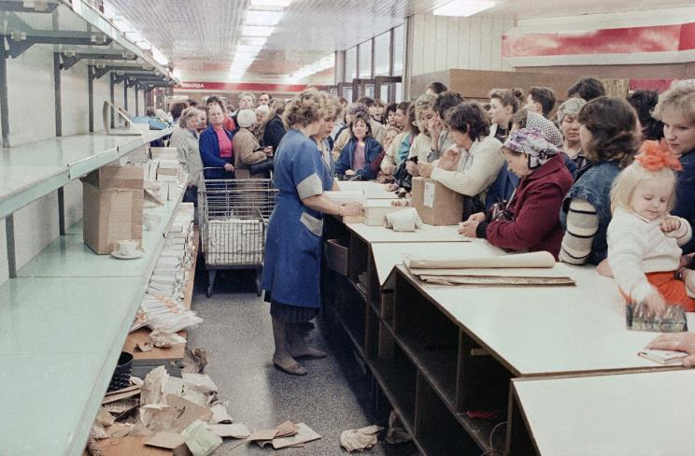
The Cold War (1947-1991)

Slide 51
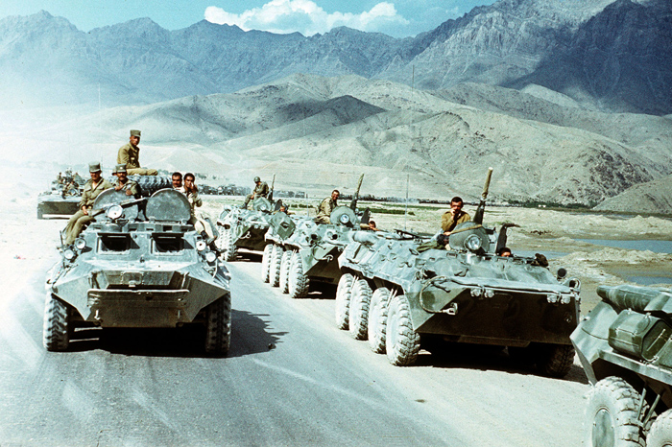
The Cold War (1947-1991)

Slide 52
The Cold War (1947-1991)
The new Cold War (1975-1985)
Soviet feeble and stagnant economy
Increase in military expenses to face Reagan’s rearmament
1985 New leader, Mijail Gorbachov, was forced to launch a plan of reforms (“perestroika”)
It failed and led to the collapse of the communist bloc(“Berlin Wall Fall,1989”) and the end of the USSR (1991)

Slide 53
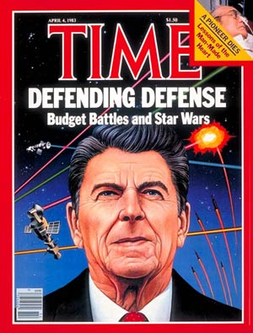
The Cold War (1947-1991)

Slide 54
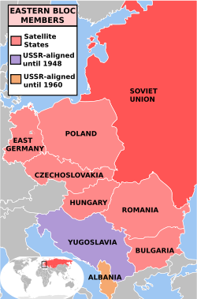
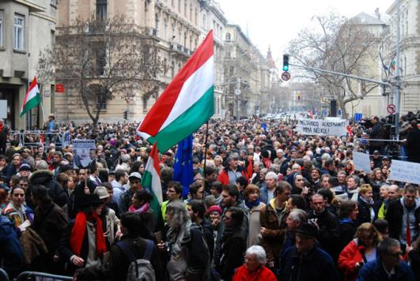
The Cold War (1947-1991)

Slide 55
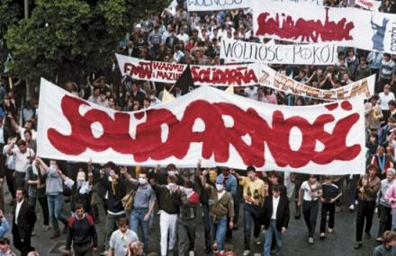
The Cold War (1947-1991)

Slide 56
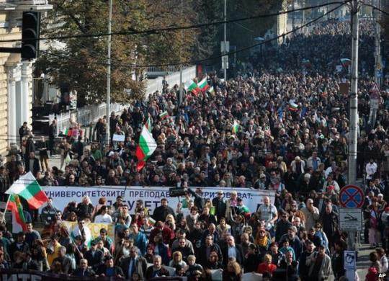
The Cold War (1947-1991)

Slide 57
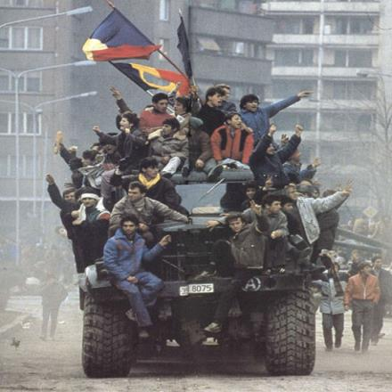
The Cold War (1947-1991)

Slide 58
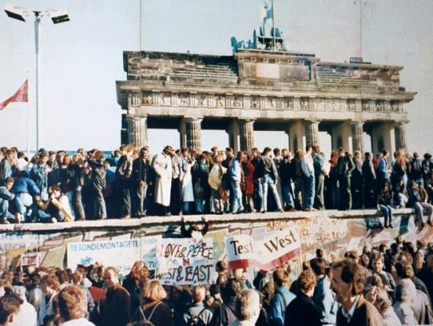
The Cold War (1947-1991)

Slide 59
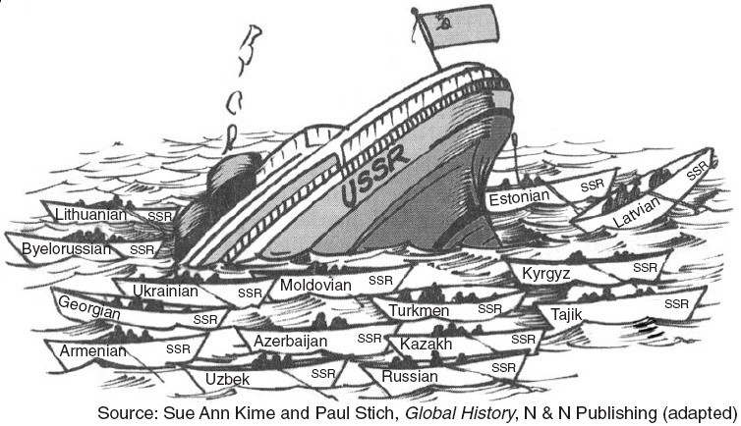
The Cold War (1947-1991)

Slide 60
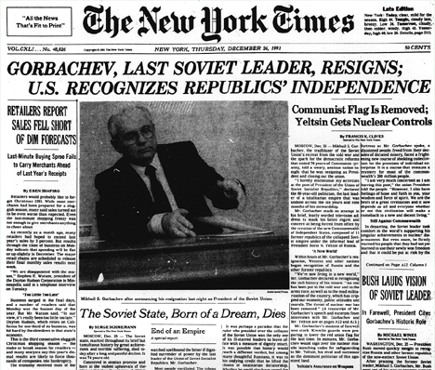
The Cold War (1947-1991)

Slide 61
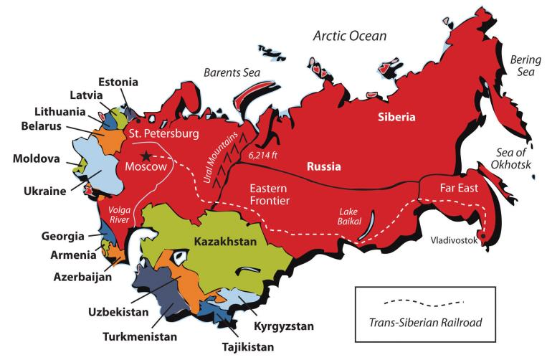
The Cold War (1947-1991)

